Slide 1
Section 9.4
Infinite Series: “Convergence Tests”

Slide 2
All graphics are attributed to:
Calculus,10/E by Howard Anton, Irl Bivens, and Stephen Davis Copyright © 2009 by John Wiley & Sons, Inc. All rights reserved.”

Slide 3
Introduction
In the last section, we showed how to find the sum of a series by finding a closed form for the nth partial sum and taking its limit.
It is often difficult, or impossible to find a closed form, so we need alternate methods.
One possibility is to prove that the series converges, and then to approximate the sum by a partial sum with “sufficiently many terms” to achieve the desired degree of accuracy.
In this section, we will develop various tests that can be used to determine whether a given series converges or diverges.

Slide 4
The Divergence Test
Rather than constantly deciding whether to start a sum with k= 0 or k= 1 like we discussed in section 9.3 (or some other desirable value), it is convenient to use the more general notation $\sum{u_{k}}$.
We can do this because the starting index value becomes irrelevant to the issue of convergence (think about “eventually”) that we discussed in section 9.2.
We call $\sum{u_{k}}$the general term of the series and there is a relationship between the limit of the general term and the convergence properties of a series.

Slide 5
The Divergence Test Theorem
Proofs of Theorem 9.4.1 (a) & (b) are on page 624 if you are interested.
Theorem 9.4.2 is an alternative form of Theorem 9.4.1 (a).

Slide 6
Converse Warning
Theorem 9.4.2 states that Its converse is false.
The converse would be: If $\lim_{k→+∞}{u_{k}}=0$, then $\sum{u_{k}}$converges.
Just because you can prove that $\lim_{k→+∞}{u_{k}}=0$, it does not prove that $\sum{u_{k}}$converges.
The reason for this is Theorem 9.4.2 which states that .
Therefore, when $\lim_{k→+∞}{u_{k}}=0$, the series $\sum{u_{k}}$ may either converge or diverge.

Slide 7
Example
S$eries: \sum_{k=1}^{+∞}{\frac{k}{k+1}}$ = $\frac{1}{2}$+ $\frac{2}{3}+ \frac{3}{4}+ \frac{4}{5}$+ … + $\frac{k}{k+1}$ + …
This diverges since $\lim_{k→+∞}{\frac{k}{k+1}}$ = $\lim_{k→+∞}\frac{1}{1+\frac{1}{k}}$ when you divide by the highest power of k in the denominator.
$\lim_{k→+∞}\frac{1}{1+\frac{1}{k}}$ = $\frac{1}{1+0}$ when $k→+∞$ which = 1 $≠$ 0 and therefore diverges.

Slide 8
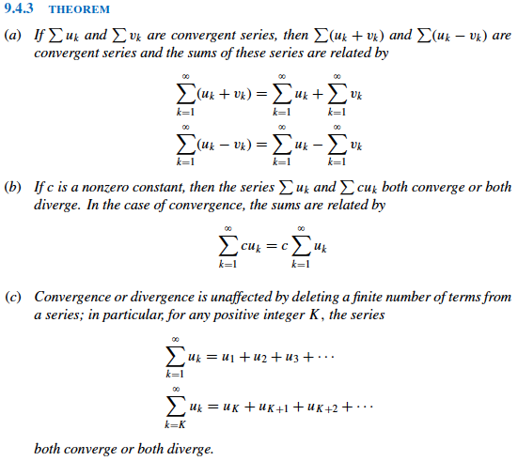
Algebraic Properties of Infinite Series

Slide 9
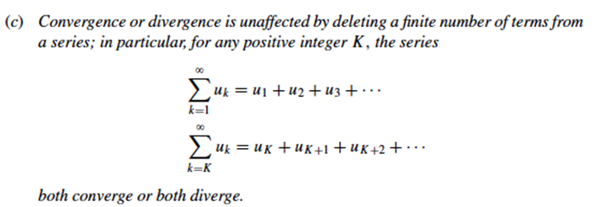
NOTE Regarding Algebraic Property (c) of Infinite Series Theorem 9.4.3
Even though convergence is not affected when finitely many terms are deleted from the beginning of a convergent series (see (c) again below), the sum of the series is changed by the removal of those terms.

Slide 10
Examples Using Algebraic Properties
Find the sum of the series $\sum_{k=1}^{∞}{\left(\frac{3}{4^{k}}−\frac{2}{5^{k−1}}\right)}$
Solution: If you look at the two separately, both converge.
$\sum_{k=1}^{∞}{\left(\frac{3}{4^{k}}\right)}$ = $\frac{3}{4}+\frac{3}{4^{2}}+\frac{3}{4^{3}}+…$ is geometric with a=$\frac{3}{4},$r=$\frac{1}{4}$ and
$\sum_{k=1}^{∞}{\left(\frac{2}{5^{k−1}}\right)}$ is also a convergent geometric series since r=$\frac{1}{5}$ therefore, their difference is also convergent = $\frac{\frac{3}{4}}{1−\frac{1}{4}}$ - $\frac{2}{1−\frac{2}{5}}$ = -$\frac{3}{2}$.
$\sum_{k=1}^{∞}{\left(\frac{5}{k}\right)}$ =5+ $\frac{5}{2}$+$\frac{5}{3}$+…+$\frac{5}{k}$+… which is 5($1+\frac{1}{2}$+ $\frac{1}{3}$+ …+ $\frac{1}{k}+$ …) = 5*the harmonic series which diverges. Therefore, $\sum_{k=1}^{∞}{\left(\frac{5}{k}\right)}$ also diverges.
$\sum_{k=10}^{∞}{\left(\frac{1}{k}\right)}$ = $\frac{1}{10}$+$\frac{1}{11}$+$\frac{1}{12}$+… is the harmonic series without the first nine terms. Therefore, it also diverges.

Slide 11
The Integral Test (proof on pg. 626)
$\sum_{k=1}^{∞}{\frac{1}{k^{2}}}$ is related to $\int_{1}^{+∞}{\frac{1}{x^{2}}}$dx in many ways.
The k in the general term of the series was replaced with x.
The limits of summation in the series are replaced by the corresponding limits of integration.
There is also a relationship between the convergence of the series and the integral:

Slide 12
Example
Show that the integral test applies, and use the integral test to determine whether the series $\sum_{k=1}^{∞}{\frac{1}{k}}$converges or diverges.
Solution: We already know that this is the divergent harmonic series, so the integral test will just prove that it diverges.
Since the terms in the series are positive, the integral test is applicable. When we replace k with x and change the limits of summation to the corresponding limits of integration, we get $\sum_{k=1}^{∞}{\frac{1}{k}}$ $\int_{1}^{+∞}{\frac{1}{x}dx}$= $\lim_{b→+∞}{\int{1/x}}$
= $\lim_{b→+∞}$ln x]₁^{b}= $\lim_{b→+∞}$(ln b – ln 1) = +$∞$ - 0 = +$∞$
Therefore, the integral diverges and consequently so does the series

Slide 13
Example
Show that the integral test applies, and use the integral test to determine whether the series $\sum_{k=1}^{∞}{\frac{1}{k2}}$converges or diverges.
Solution:
Since the terms in the series are positive, the integral test is applicable. When we replace k with x and change the limits of summation to the corresponding limits of integration, we get $\sum_{k=1}^{∞}{\frac{1}{k2}}$ $\int_{1}^{+∞}{\frac{1}{x2}dx}$
= $\lim_{b→+∞}{−1/x}$ ]₁^{b} = $\lim_{b→+∞}$($−\frac{1}{b}−−\frac{1}{1})$ = 0+1=1
Therefore, the integral converges and consequently the series converges by the integral test with a=1.

Slide 14
Previous Example Warning
Just because the integral in the previous example was equal to 1, that does not mean that the sum is 1.
If you list the first two terms $\frac{1}{12}$ + $\frac{1}{22}$, that sum is already bigger than 1 so the infinite sum is definitely bigger than 1.
We will prove in a later section of this chapter that the sum of the series is actually $\frac{π^{2}}{6}$

Slide 15
p-Series
The last example is a special case of a class of series called p-series or hyperharmonic series.
A p-series is an infinite series of the form:
$\sum_{k=1}^{∞}{\frac{1}{kp}}$ = 1 + $\frac{1}{2^{p}}$ + $\frac{1}{3^{p}}$ + … + $\frac{1}{k^{p}}$ + … where p>0

Slide 16
Proof of the Convergence of p-Series
We can use the integral test to prove the convergence of p-series when p$≠$1.
$\sum_{k=1}^{∞}{\frac{1}{kp}}$ $\int_{1}^{+∞}{\frac{1}{xp}dx}$ = $\int_{1}^{+∞}{x^{−p}dx}$
= $\lim_{b→+∞}{\frac{x^{−p+1}}{−p+1}}$ ]₁^{b} = $\lim_{b→+∞}$($\frac{b^{−p+1}}{−p+1}−\frac{1}{−p+1})$
This result has different possible outcomes.
If p>1, then –p+1<0 and the numerator $b^{−p+1}$ goes to zero as $b→+∞$ and the integral converges to $−\frac{1}{−p+1}$ and the series also converges.
If 0<p<1, then –p+1>0 and the numerator $b^{−p+1}$ goes to $+∞$ as $b→+∞$ and the integral and series both diverge.
When p=1, we get the harmonic series which also diverges.

Slide 17
Example of a p-Series
Tell whether the series 1 + $\frac{1}{\sqrt[3]{2}}$ + $\frac{1}{\sqrt[3]{3}}$ + …+ $\frac{1}{\sqrt[3]{k}}$ + … converges or diverges and why.
Solution:
This series diverges since it is a p-series with p=$\frac{1}{3}$ which is less than one.

Slide 18
Getting Ready for the Holidays

